Slide 1
第28讲 防火墙
闫巧 教授

Slide 2
大 纲
什么是防火墙
防火墙的作用
防火墙的局限
防火墙的类型
防火墙的工作模式
防火墙的部署
防火墙的性能指标

Slide 3
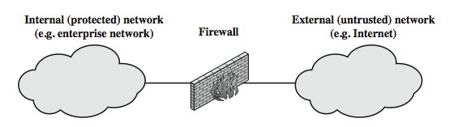
1、什么是防火墙？
防火墙原是指建筑群中防止火灾蔓延的墙。在计算机网络中是指设置在可信任的内部网络和不可信任的外界之间的屏障，通过强化边界控制保障内容安全，同时不妨碍内部对外部的访问。
Notes:
Stallings Figure 11.1a illustrates the general model of firewall use on the security perimeter, as a choke point for traffic between between the external less-trusted Internet and the internal more trusted private network.

Slide 4
2、防火墙的作用
强化网络安全策略：具有不同信任的互连网络
防止网络故障蔓延
对网络访问进行监控审核和报警
提供流量控制（带宽管理）和计费
利用IPSec实现VPN
实现MAC与IP地址的绑定
Notes:
A firewall is inserted between the premises network and the Internet to establish a controlled link and to erect an outer security wall or perimeter, forming a single choke point where security and audit can be imposed. A firewall:
defines a single choke point that keeps unauthorized users out of the protected network, prohibits potentially vulnerable services from entering or leaving the network, and provides protection from various kinds of IP spoofing and routing attacks.
2. provides a location for monitoring security-related events
3. is a convenient platform for several Internet functions that are not security related, such as NAT and Internet usage audits or logs
4. A firewall can serve as the platform for IPSec to implement virtual private networks.
The firewall itself must be immune to penetration, since it will be a target of attack.

Slide 5
3、防火墙的局限性
防火墙可能被绕过
无法抵御内部威胁
如不满的或串通的员工
不能防止对开放端口（服务）的攻击。
防火墙可以阻断攻击，但无法消除攻击源。
防火墙自身也可能会受到攻击。
Notes:
Firewalls have their limitations, including that they:
1. cannot protect against attacks that bypass the firewall, eg PCs with dial-out capability to an ISP, or dial-in modem pool use
2. do not protect against internal threats, eg disgruntled employee or one who cooperates with an attacker
3. An improperly secured wireless LAN may be accessed from outside the organization. An internal firewall that separates portions of an enterprise network cannot guard against wireless communications between local systems on different sides of the internal firewall.
4. A laptop, PDA, or portable storage device may be used and infected outside the corporate network, and then attached and used internally.

Slide 6
4、防火墙的种类
按照采用技术不同
包过滤型防火墙、代理防火墙、状态检测防火墙、地址转换防火墙。
按照实现形态不同
软件防火墙、硬件防火墙
按照部署位置不同
边界防火墙、个人防火墙、混合防火墙
Notes:
Have three common types of firewalls: packet filters, application-level gateways, & circuit-level gateways.
A packet-filtering router applies a set of rules to each incoming and outgoing IP packet to forward or discard the packet. Filtering rules are based on information contained in a network packet such as src & dest IP addresses, ports, transport protocol & interface. Some advantages are simplicity, transparency & speed.
If there is no match to any rule, then one of two default policies are applied:
• that which is not expressly permitted is prohibited (default action is discard packet), conservative policy
• that which is not expressly prohibited is permitted (default action is forward packet), permissive policy

Slide 7
4.1 包过滤型防火墙
最简单、最快的防火墙
任何防火墙系统的基础
检查每个IP数据包（没有上下文）按规则
允许或拒绝，查看的信息包括源IP地址、目的IP地址、TCP/UDP端口号、承载协议等
可能的默认策略
不指定允许的，都禁止
不指定禁止的，都允许
Notes:
Have three common types of firewalls: packet filters, application-level gateways, & circuit-level gateways.
A packet-filtering router applies a set of rules to each incoming and outgoing IP packet to forward or discard the packet. Filtering rules are based on information contained in a network packet such as src & dest IP addresses, ports, transport protocol & interface. Some advantages are simplicity, transparency & speed.
If there is no match to any rule, then one of two default policies are applied:
• that which is not expressly permitted is prohibited (default action is discard packet), conservative policy
• that which is not expressly prohibited is permitted (default action is forward packet), permissive policy

Slide 8
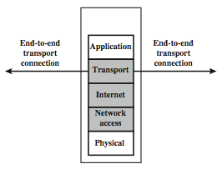
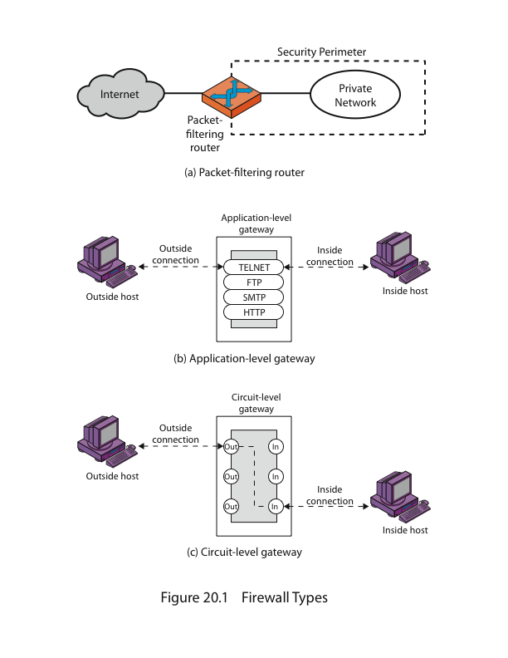
4.1 包过滤型防火墙
Notes:
Stallings Figure 11.1b (along with 4/e Figure 20.1a) illustrates the packet filter firewall role as utilising information from the transport, network & data link layers to make decisions on allowable traffic flows, and its placement in the border router between the external less-trusted Internet and the internal more trusted private network.

Slide 9
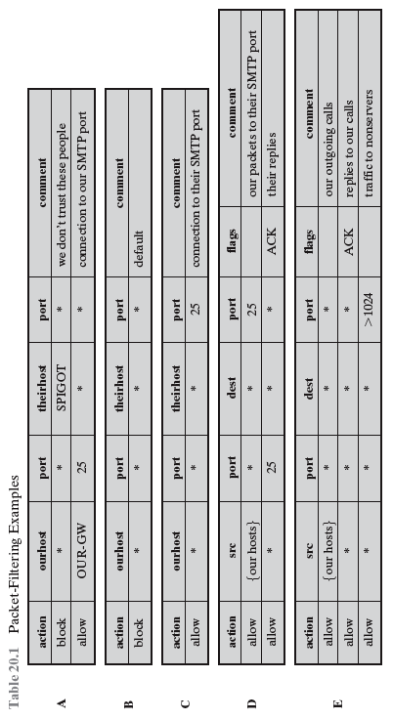
4.1 包过滤型防火墙
Notes:
Stallings Table 11.1 gives some examples of packet-filtering rule sets. In each set, the rules are applied top to bottom.
A. Inbound mail is allowed to a gateway host only (port 25 is for SMTP incoming
B. explicit statement of the default policy
C. tries to specify that any inside host can send mail to the outside, but has problem that an outside machine could be configured to have some other application linked to port 25
D. properly implements mail sending rule, by checking ACK flag of a TCP segment is set
E. this rule set is one approach to handling FTP connections

Slide 10
包过滤型防火墙可能受到的攻击
4.1 包过滤型防火墙
IP地址欺骗
信任一个假地址
在路由器上添加过滤器以阻止
源路由攻击
攻击者设置默认路由
阻止源路由数据包
微小碎片攻击
在几个小数据包上分割头信息
在检查前丢弃或重新组装
Notes:
Some of the attacks that can be made on packet-filtering routers & countermeasures are:
• IP address spoofing: where intruder transmits packets from the outside with internal host source IP addr, need to filter & discard such packets
• Source routing attacks: where source specifies the route that a packet should take to bypass security measures, should discard all source routed packets
• Tiny fragment attacks: intruder uses the IP fragmentation option to create extremely small fragments and force the TCP header information into a separate fragments to circumvent filtering rules needing full header info, can enforce minimum fragment size to include full header.

Slide 11
4.2 代理防火墙
工作过程：
用户将请求的服务发送给代理防火墙
代理防火墙验证请求为合法后向网络应用服务器发送请求
网络应用服务器将服务数据发送给代理防火墙，代理防火墙将数据发送给用户
代理防火墙又包括应用级代理、电路级代理、
Notes:
An application-level gateway (or proxy server), acts as a relay of application-level traffic. A user contacts the gateway to access some service, provides details of the service, remote host & authentication details, contacts the application on the remote host and relays all data between the two endpoints. If the gateway does not implement the proxy code for a specific application, then it is not supported and cannot be used. Note that some services naturally support proxying, whilst others are more problematic. Application-level gateways tend to be more secure than packet filters, &can log and audit traffic at application level.

Slide 12
4.2.1 应用级代理
也被称作应用级网关
每个服务需要单独的代理服务
应用级网关可以在应用程序级别记录/审核流量
Notes:
An application-level gateway (or proxy server), acts as a relay of application-level traffic. A user contacts the gateway to access some service, provides details of the service, remote host & authentication details, contacts the application on the remote host and relays all data between the two endpoints. If the gateway does not implement the proxy code for a specific application, then it is not supported and cannot be used. Note that some services naturally support proxying, whilst others are more problematic. Application-level gateways tend to be more secure than packet filters, &can log and audit traffic at application level.

Slide 13
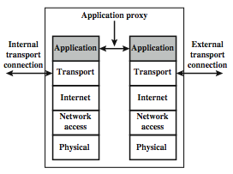
4.2.1 应用级代理
Notes:
Stallings Figure 11.1d (along with 4/e Figure 20.1b) illustrates an application-level gateway (or proxy server), emphasizing that it only supports a specific list of application services.

Slide 14
4.2.2 电路级代理
也被称作电路层网关，工作在OSI模型的会话层，维护一张合法的会话连接表，进行会话层过滤。一旦认为会话合法，就为双方建立连接，之后就作为数据的中转站，不再进行审查。
Notes:
An application-level gateway (or proxy server), acts as a relay of application-level traffic. A user contacts the gateway to access some service, provides details of the service, remote host & authentication details, contacts the application on the remote host and relays all data between the two endpoints. If the gateway does not implement the proxy code for a specific application, then it is not supported and cannot be used. Note that some services naturally support proxying, whilst others are more problematic. Application-level gateways tend to be more secure than packet filters, &can log and audit traffic at application level.

Slide 15
4.3 状态检测型防火墙
传统的包过滤不检查更高一层的语境
即匹配返回包和外向流
状态检测型防火墙扩展了包过滤防火墙，跟踪每个通过TCP连接的状态，将属于同一连接的所有包作为一个整体的数据流看待。
跟踪客户机服务器会话
检查每个包是否有效属于一个会话
因此，能够在上下文中更好地检测伪造包
甚至可能检查有限的应用程序数据
Notes:
A traditional packet filter makes filtering decisions on an individual packet basis and does not take into consideration any higher layer context. In general, when an application that uses TCP creates a session with a remote host, it creates a TCP connection in which the TCP port number for the remote (server) application is a number less than 1024 and the TCP port number for the local (client) application is a number between 1024 and 65535. A simple packet filtering firewall must permit inbound network traffic on all these high- numbered ports for TCP-based traffic to occur. This creates a vulnerability that can be exploited by unauthorized users. A stateful inspection packet filter tightens up the rules for TCP traffic by creating a directory of outbound TCP connections, and will allow incoming traffic to high-numbered ports only for those packets that fit the profile of one of the entries in this directory. Hence they are better able to detect bogus packets sent out of context. A stateful packet inspection firewall reviews the same packet information as a packet filtering firewall, but also records information about TCP connections. Some stateful firewalls also keep track of TCP sequence numbers to prevent attacks that depend on the sequence number, such as session hijacking. Some even inspect limited amounts of application data for some well-known protocols like FTP, IM and SIPS commands, in order to identify and track related connections.

Slide 16
4.4 网络地址转换型防火墙
网络地址转换（NAT）就是使用两套IP地址：内部IP地址（私有IP地址）和外部IP地址（公共IP地址）。
私有IP地址块：
A类：10.0.0.0~10.255.255.255
B类：172.16.0.0~172.31.0.0
C类：192.168.0.0~192.168.255.255
Notes:
A traditional packet filter makes filtering decisions on an individual packet basis and does not take into consideration any higher layer context. In general, when an application that uses TCP creates a session with a remote host, it creates a TCP connection in which the TCP port number for the remote (server) application is a number less than 1024 and the TCP port number for the local (client) application is a number between 1024 and 65535. A simple packet filtering firewall must permit inbound network traffic on all these high- numbered ports for TCP-based traffic to occur. This creates a vulnerability that can be exploited by unauthorized users. A stateful inspection packet filter tightens up the rules for TCP traffic by creating a directory of outbound TCP connections, and will allow incoming traffic to high-numbered ports only for those packets that fit the profile of one of the entries in this directory. Hence they are better able to detect bogus packets sent out of context. A stateful packet inspection firewall reviews the same packet information as a packet filtering firewall, but also records information about TCP connections. Some stateful firewalls also keep track of TCP sequence numbers to prevent attacks that depend on the sequence number, such as session hijacking. Some even inspect limited amounts of application data for some well-known protocols like FTP, IM and SIPS commands, in order to identify and track related connections.

Slide 17
4.4 网络地址转换型防火墙
基本NAT的实现包括两种方法：
静态NAT:私有IP地址与公共IP地址具有一对一关系。
动态NAT:私有IP地址与公共IP地址具有动态（临时）一对一关系。全局地址放入NAT池。
网络地址端口转换（NAPT)：将内部地址映射到外部网络IP地址的不同端口上。
Notes:
A traditional packet filter makes filtering decisions on an individual packet basis and does not take into consideration any higher layer context. In general, when an application that uses TCP creates a session with a remote host, it creates a TCP connection in which the TCP port number for the remote (server) application is a number less than 1024 and the TCP port number for the local (client) application is a number between 1024 and 65535. A simple packet filtering firewall must permit inbound network traffic on all these high- numbered ports for TCP-based traffic to occur. This creates a vulnerability that can be exploited by unauthorized users. A stateful inspection packet filter tightens up the rules for TCP traffic by creating a directory of outbound TCP connections, and will allow incoming traffic to high-numbered ports only for those packets that fit the profile of one of the entries in this directory. Hence they are better able to detect bogus packets sent out of context. A stateful packet inspection firewall reviews the same packet information as a packet filtering firewall, but also records information about TCP connections. Some stateful firewalls also keep track of TCP sequence numbers to prevent attacks that depend on the sequence number, such as session hijacking. Some even inspect limited amounts of application data for some well-known protocols like FTP, IM and SIPS commands, in order to identify and track related connections.

Slide 18
5、防火墙的工作模式
防火墙的工作模式包括3种
路由模式
防火墙以第3层对外连接（接口具有IP地址）。
透明模式
防火墙以第2层对外连接（接口无IP地址）。
混合模式
若防火墙既存在工作在路由模式的接口也存在工作在透明模式的接口。
Notes:
Have three common types of firewalls: packet filters, application-level gateways, & circuit-level gateways.
A packet-filtering router applies a set of rules to each incoming and outgoing IP packet to forward or discard the packet. Filtering rules are based on information contained in a network packet such as src & dest IP addresses, ports, transport protocol & interface. Some advantages are simplicity, transparency & speed.
If there is no match to any rule, then one of two default policies are applied:
• that which is not expressly permitted is prohibited (default action is discard packet), conservative policy
• that which is not expressly prohibited is permitted (default action is forward packet), permissive policy

Slide 19
6、防火墙的部署
屏蔽路由器和屏蔽主机(Screened Host )
双宿/多宿主机(Dual-Homed /Multi-Homed Host Firewall)
堡垒主机（Bastion Host）
屏蔽子网防火墙(Screened Subnet Firewall）
Notes:
Have three common types of firewalls: packet filters, application-level gateways, & circuit-level gateways.
A packet-filtering router applies a set of rules to each incoming and outgoing IP packet to forward or discard the packet. Filtering rules are based on information contained in a network packet such as src & dest IP addresses, ports, transport protocol & interface. Some advantages are simplicity, transparency & speed.
If there is no match to any rule, then one of two default policies are applied:
• that which is not expressly permitted is prohibited (default action is discard packet), conservative policy
• that which is not expressly prohibited is permitted (default action is forward packet), permissive policy

Slide 20
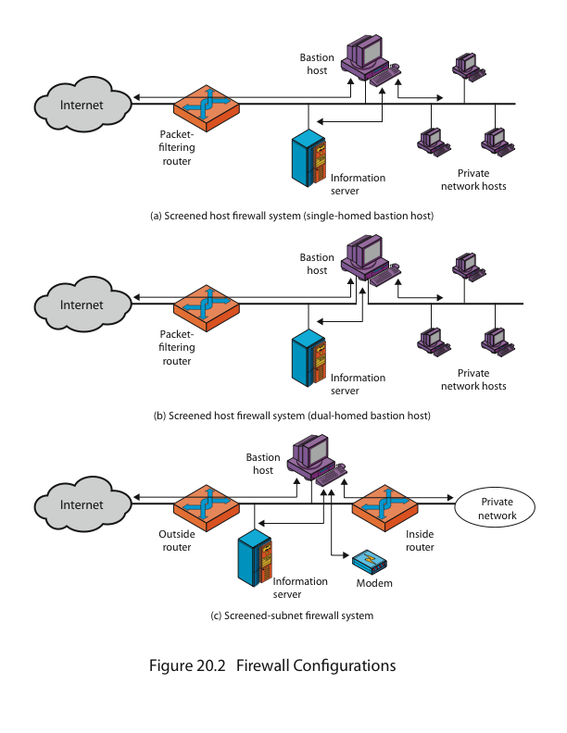
6.1 屏蔽路由器和屏蔽主机
具有数据包过滤功能的路由器叫屏蔽路由器，具有数据包过滤功能的主机叫屏蔽主机。
Notes:
Have three common types of firewalls: packet filters, application-level gateways, & circuit-level gateways.
A packet-filtering router applies a set of rules to each incoming and outgoing IP packet to forward or discard the packet. Filtering rules are based on information contained in a network packet such as src & dest IP addresses, ports, transport protocol & interface. Some advantages are simplicity, transparency & speed.
If there is no match to any rule, then one of two default policies are applied:
• that which is not expressly permitted is prohibited (default action is discard packet), conservative policy
• that which is not expressly prohibited is permitted (default action is forward packet), permissive policy

Slide 21
6.2 双穴主机
双宿主机（Dual-homed Host）：有两个网络接口的计算机系统，一个接口连接内部网，一个接口连接外部网.
Notes:
Have three common types of firewalls: packet filters, application-level gateways, & circuit-level gateways.
A packet-filtering router applies a set of rules to each incoming and outgoing IP packet to forward or discard the packet. Filtering rules are based on information contained in a network packet such as src & dest IP addresses, ports, transport protocol & interface. Some advantages are simplicity, transparency & speed.
If there is no match to any rule, then one of two default policies are applied:
• that which is not expressly permitted is prohibited (default action is discard packet), conservative policy
• that which is not expressly prohibited is permitted (default action is forward packet), permissive policy

Slide 22
6.3 堡垒主机
堡垒主机（Bastion Host）：堡垒主机是一种配置了安全防范措施的网络上的计算机，堡垒主机为网络之间的通信提供了一个阻塞点，也就是说如果没有堡垒主机，网络之间将不能相互访问。可以配置成过滤型、代理型或混合型。
Notes:
Have three common types of firewalls: packet filters, application-level gateways, & circuit-level gateways.
A packet-filtering router applies a set of rules to each incoming and outgoing IP packet to forward or discard the packet. Filtering rules are based on information contained in a network packet such as src & dest IP addresses, ports, transport protocol & interface. Some advantages are simplicity, transparency & speed.
If there is no match to any rule, then one of two default policies are applied:
• that which is not expressly permitted is prohibited (default action is discard packet), conservative policy
• that which is not expressly prohibited is permitted (default action is forward packet), permissive policy

Slide 23
6.4 屏蔽子网防火墙
屏蔽子网防火墙：它是在被保护网络和Internet之间设置了一个独立的子网作为防火墙。
Notes:
Have three common types of firewalls: packet filters, application-level gateways, & circuit-level gateways.
A packet-filtering router applies a set of rules to each incoming and outgoing IP packet to forward or discard the packet. Filtering rules are based on information contained in a network packet such as src & dest IP addresses, ports, transport protocol & interface. Some advantages are simplicity, transparency & speed.
If there is no match to any rule, then one of two default policies are applied:
• that which is not expressly permitted is prohibited (default action is discard packet), conservative policy
• that which is not expressly prohibited is permitted (default action is forward packet), permissive policy

Slide 24
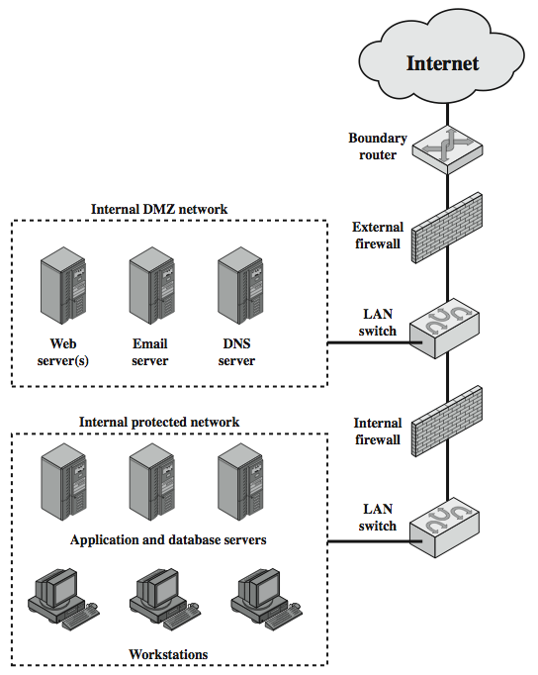
DMZ网络
DMZ一般指两台包过滤防火墙之间的区域，成为非军事区。
Notes:
Stallings Figure 11.3 further illustrates the use of a “screened subnet”, also known as a demilitarized zone (DMZ), located between an internal and an external firewall. An external firewall is placed at the edge of a local or enterprise network, just inside the boundary router that connects to the Internet or some wide area network (WAN). One or more internal firewalls protect the bulk of the enterprise network. Systems that are externally accessible but need some protections are usually located on DMZ networks. Typically, the systems in the DMZ require or foster external connectivity, such as a corporate Web site, an e-mail server, or a DNS (domain name system) server. The external firewall provides a measure of access control and protection for the DMZ systems consistent with their need for external connectivity. The external firewall also provides a basic level of protection for the remainder of the enterprise network. In this type of configuration, internal firewalls serve three purposes:
The internal firewall adds more stringent filtering capability, vs the external firewall, to protect enterprise servers and workstations from external attack.
The internal firewall provides two-way protection with respect to the DMZ, as it protects the remainder of the network from attacks launched from DMZ systems, and protects DMZ systems from attack by internal hosts.
Multiple internal firewalls can be used to protect portions of the internal network from each other.
A common practice is to place the DMZ on a different network interface on the external firewall from that used to access the internal networks.

Slide 25
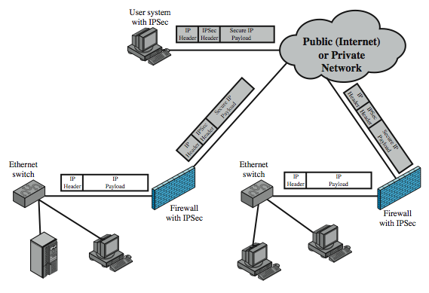
虚拟私人网络
Notes:
In today's distributed computing environment, the virtual private network (VPN) offers an attractive solution to network managers. The VPN consists of a set of computers that interconnect by means of a relatively unsecure network and that make use of encryption and special protocols to provide security. At each corporate site, workstations, servers, and databases are linked by one or more local area networks (LANs). The Internet or some other public network can be used to interconnect sites, providing a cost savings over the use of a private network and offloading the wide area network management task to the public network provider. That same public network provides an access path for telecommuters and other mobile employees to log on to corporate systems from remote sites.
A logical means of implementing an IPSec is in a firewall, as shown in Stallings Figure 11.4, which essentially repeats Figure 19.1. If IPSec is implemented in a separate box behind (internal to) the firewall, then VPN traffic passing through the firewall in both directions is encrypted. In this case, the firewall is unable to perform its filtering function or other security functions, such as access control, logging, or scanning for viruses. IPSec could be implemented in the boundary router, outside the firewall. However, this device is likely to be less secure than the firewall and thus less desirable as an IPSec platform.

Slide 26
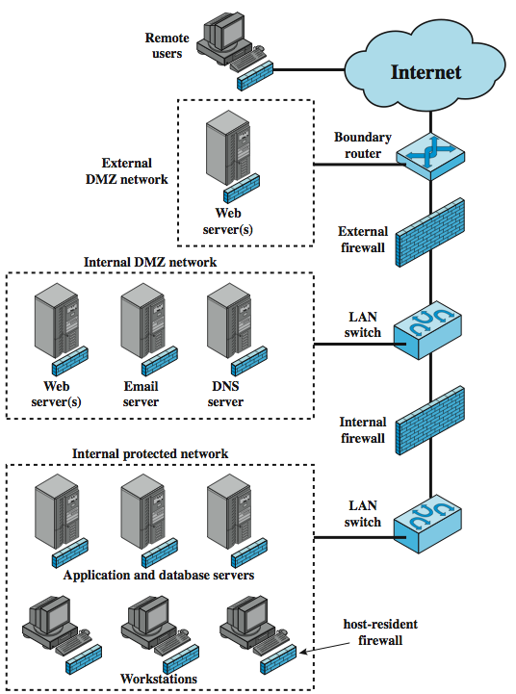
分布式防火墙
Notes:
A distributed firewall configuration involves stand-alone firewall devices plus host-based firewalls working together under a central administrative control. Stallings Figure 11.5 suggests a distributed firewall configuration. Administrators can configure host-resident firewalls on hundreds of servers and workstation as well as configure personal firewalls on local and remote user systems. Tools let the network administrator set policies and monitor security across the entire network. These firewalls protect against internal attacks and provide protection tailored to specific machines and applications. Stand-alone firewalls provide global protection, including internal firewalls and an external firewall, as discussed previously. With distributed firewalls, it may make sense to establish both an internal and an external DMZ. Web servers that need less protection because they have less critical information on them could be placed in an external DMZ, outside the external firewall. What protection is needed is provided by host-based firewalls on these servers. An important aspect of a distributed firewall configuration is security monitoring. Such monitoring typically includes log aggregation and analysis, firewall statistics, and fine-grained remote monitoring of individual hosts if needed.

Slide 27
7、防火墙的性能指标
吞吐量
延时
丢包率
背靠背
最大并发连接数
最大并发连接建立速率
最大策略数
平均无故障间隔时间
支持的最大用户数
Notes:
Have three common types of firewalls: packet filters, application-level gateways, & circuit-level gateways.
A packet-filtering router applies a set of rules to each incoming and outgoing IP packet to forward or discard the packet. Filtering rules are based on information contained in a network packet such as src & dest IP addresses, ports, transport protocol & interface. Some advantages are simplicity, transparency & speed.
If there is no match to any rule, then one of two default policies are applied:
• that which is not expressly permitted is prohibited (default action is discard packet), conservative policy
• that which is not expressly prohibited is permitted (default action is forward packet), permissive policy

Slide 28
吞吐量
定义：在不丢包的情况下能够达到的最大速率
衡量标准：吞吐量作为衡量防火墙性能的重要指标之一,吞吐量小就会造成网络新的瓶颈，以至影响到整个网络的性能
101100101000011111001010010001001000
~;%#@*$^&*&^#**(&
以最大速率发包
直到出现丢包时的最大值
Smartbits 6000B 测试仪
100M
60M
防火墙吞吐量小就会成为网络的瓶颈

Slide 29
延时
定义：入口处输入帧最后1个比特到达至出口处输出帧的第1个比特输出所用的时间间隔
衡量标准：防火墙的时延能够体现它处理数据的速度
时间间隔
最后1个比特到达
第一个比特输出
101100101000011111001010010001001000
10101001001001001010
Smartbits 6000B 测试仪
造成数据包延迟到达目标地
数据包首先排队待
防火墙检查后转发
1010100111001110
1010100111001110
1010010010100100010100010
101010100100100100100100010

Slide 30
丢包率
定义：在连续负载的情况下，防火墙设备由于资源不足应转发但却未转发的帧百分比
衡量标准：防火墙的丢包率对其稳定性、可靠性有很大的影响
丢包率=（1000-800）/1000=20%
防火墙由于资源不足只转发了800个包
发送了1000个包
10010101001010010001001001
10010101001010010001001001
Smartbits 6000B 测试仪

Slide 31
背靠背
定义：从空闲状态开始，以达到传输介质最小合法间隔极限的传输速率发送相当数量的固定长度的帧，当出现第一个帧丢失时，发送的帧数。
衡量标准：背靠背包的测试结果能体现出被测防火墙的缓冲容量，网络上经常有一些应用会产生大量的突发数据包（例如：备份，路由更新等），而且这样的数据包的丢失可能会产生更多的数据包，强大缓冲能力可以减小这种突发对网络造成的影响
包数量（n）
背靠背指标体现防火墙对突发数据的处理能力
峰值
时间（t）
少量包
包增多
包减少
没有数据
Smartbits 6000B 测试仪

Slide 32
参考文献
[1]张基温. 信息系统安全教程.清华大学出版社

Slide 33
回 顾
本讲介绍了什么是防火墙，防火墙的作用和局限，防火墙的类型和工作模式以及防火墙的部署和性能指标，相信我们对防火墙已经具备了一定的了解，下一讲我们将介绍另一种安全设备-入侵检测系统。

